Slide 1
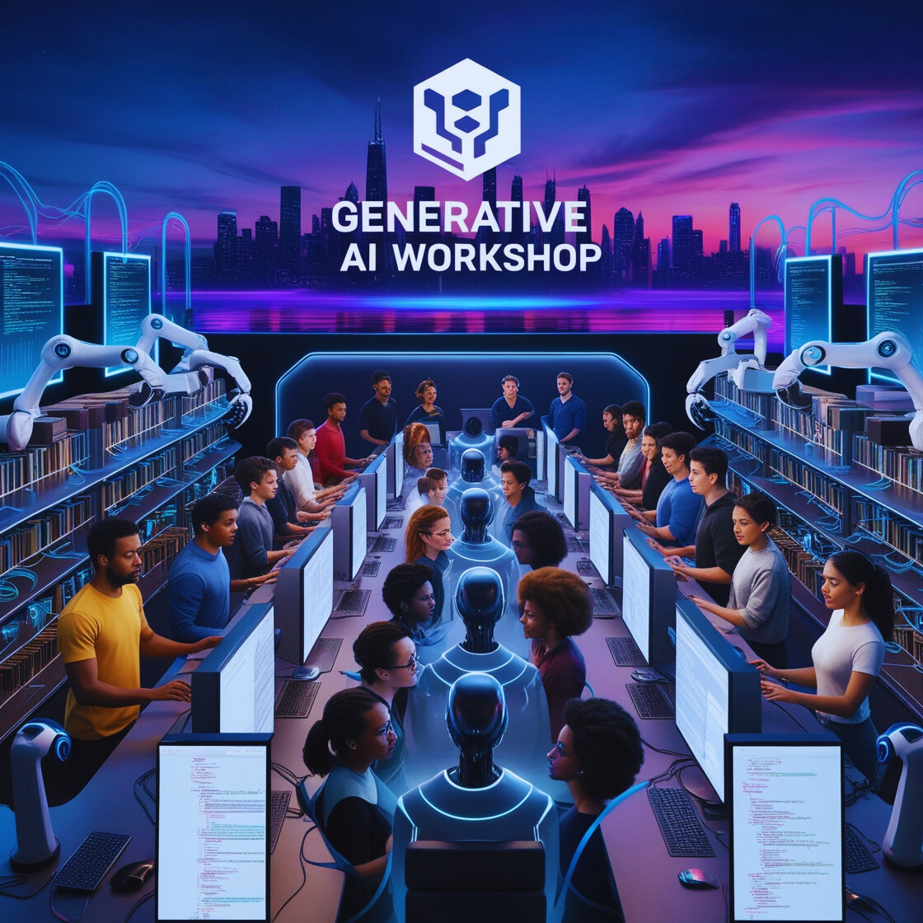
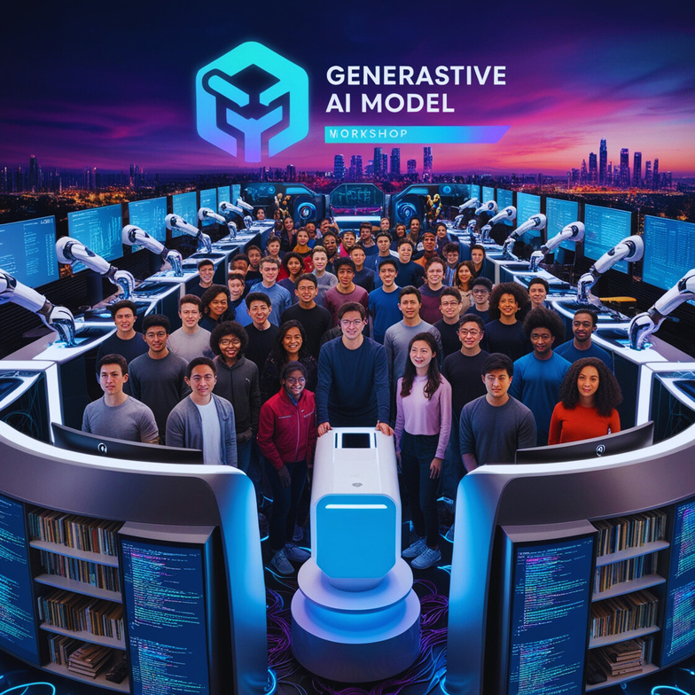

From Ideas to
Generative Models

Slide 2
Agenda
What’s AI
AI vs ML vs DL
AI in our Lives
Machine Learning
Types of ML
Advantages of ML
Deep Learning
Advantages of DL
Generative AI
Applications of Generative AI
Types of Generative AI
Fine-Tuning and Customizing Generative Models
Quantum AI

Slide 3
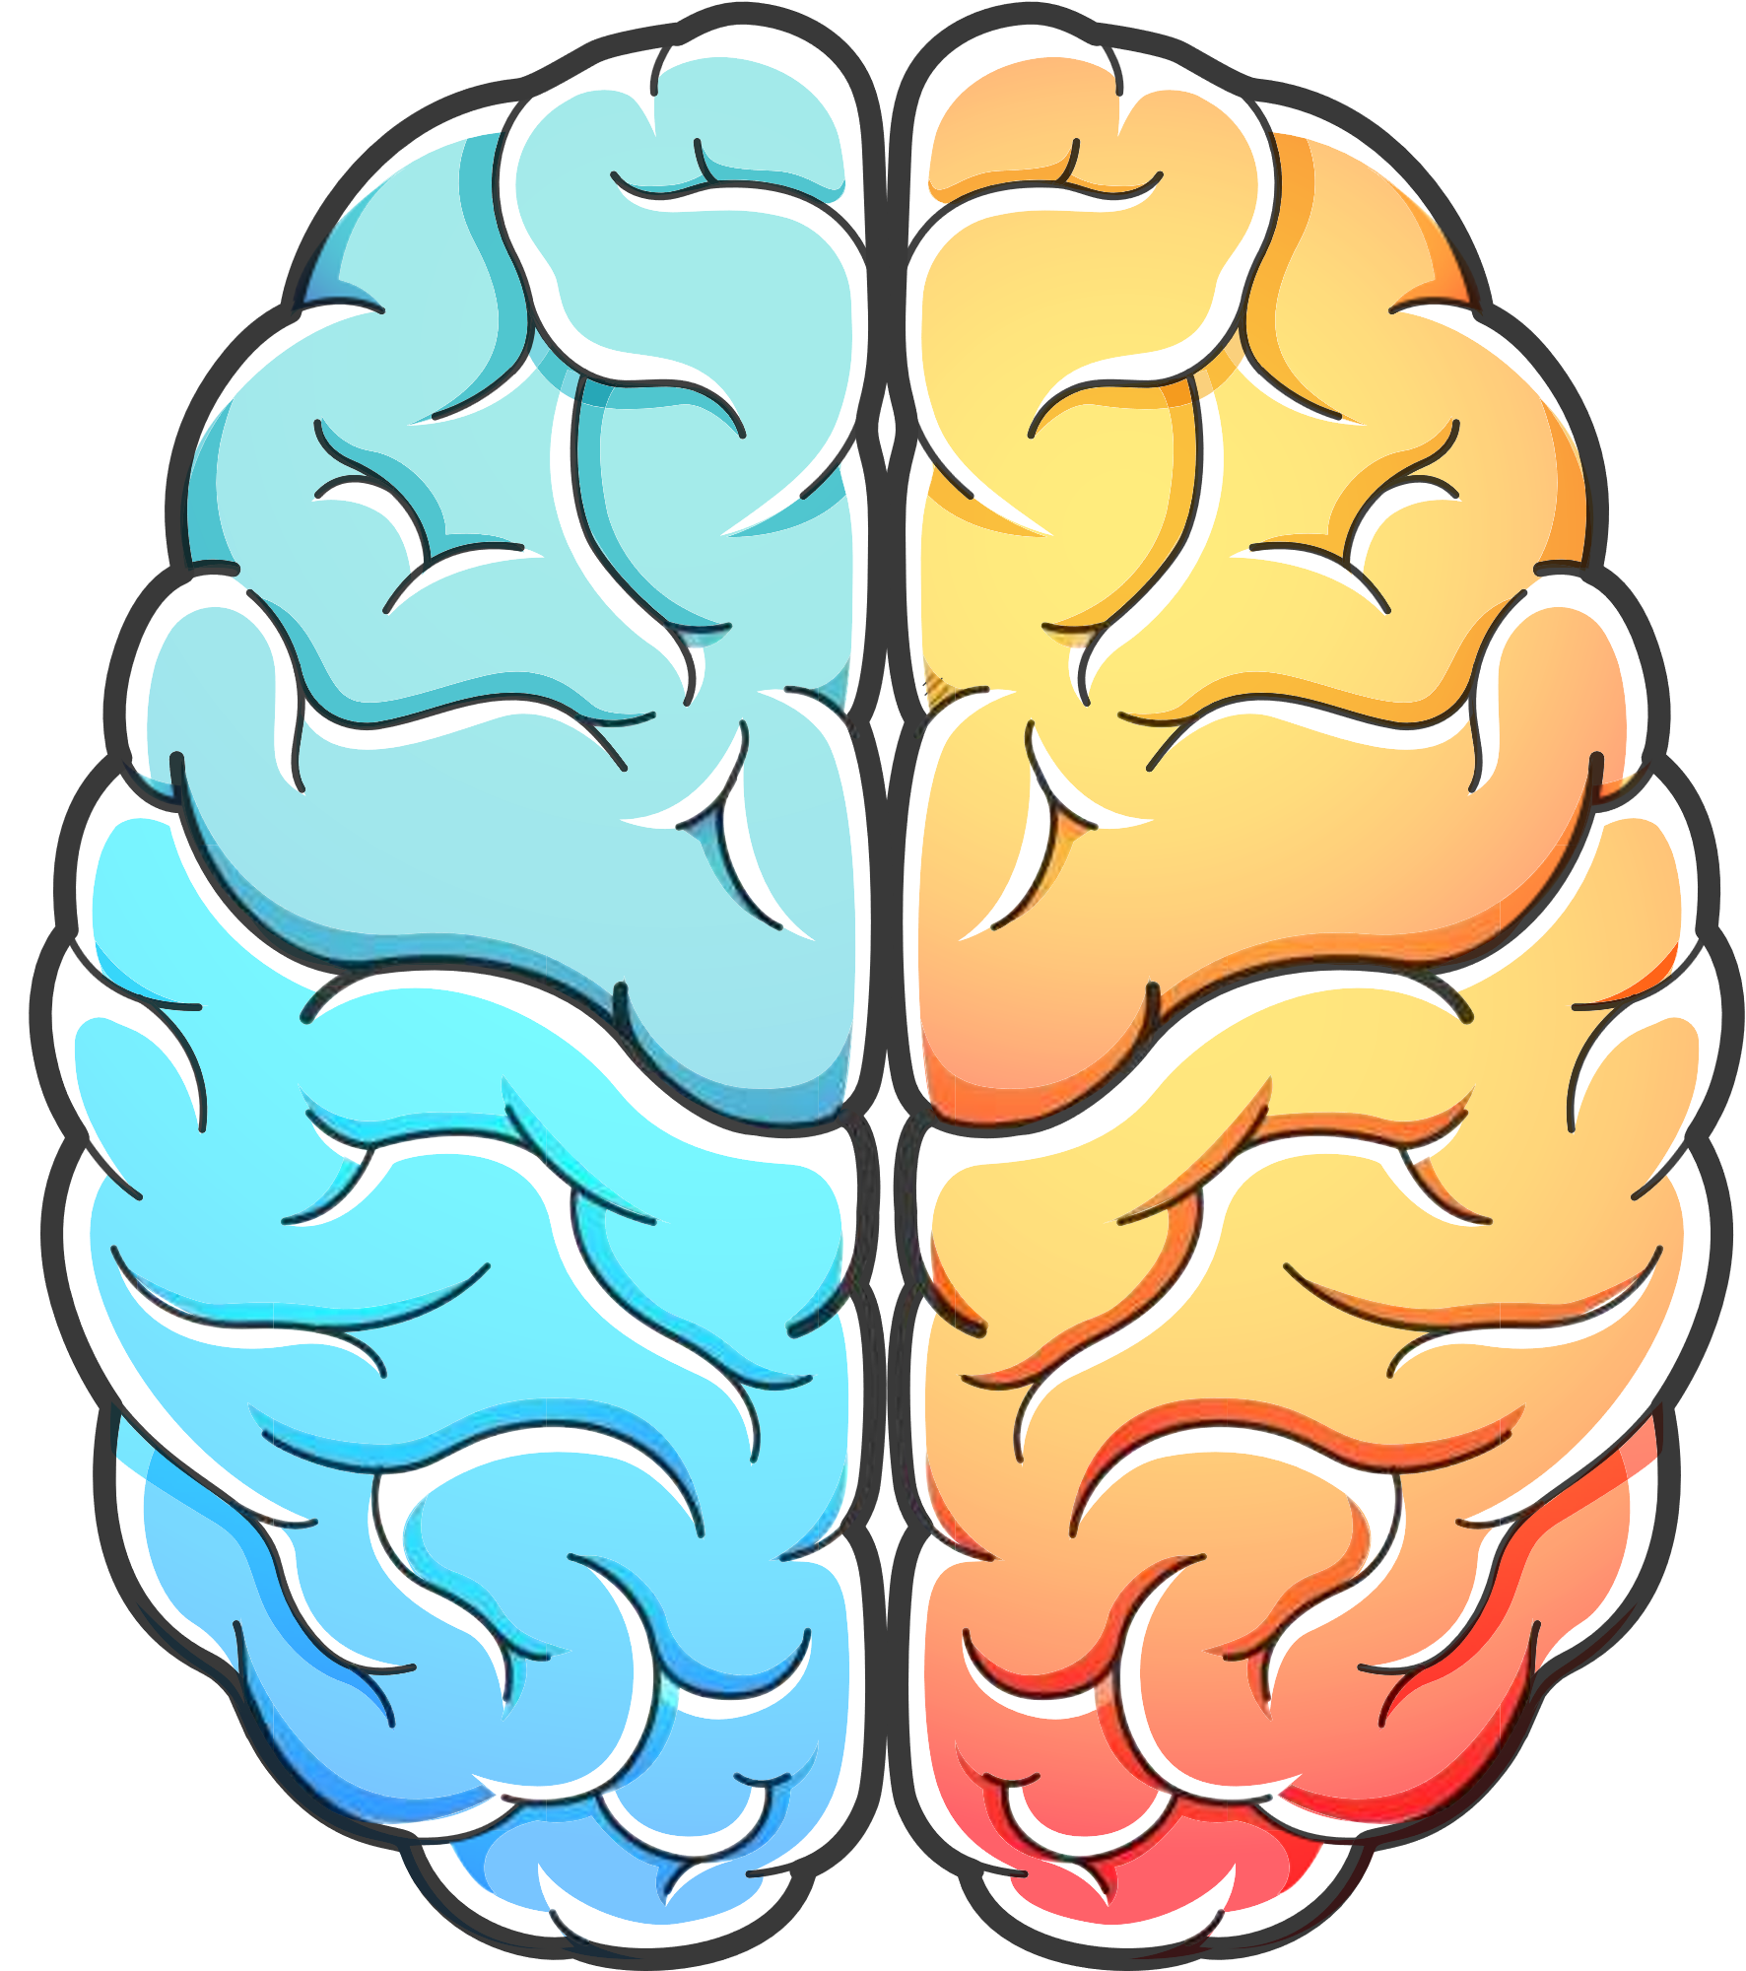
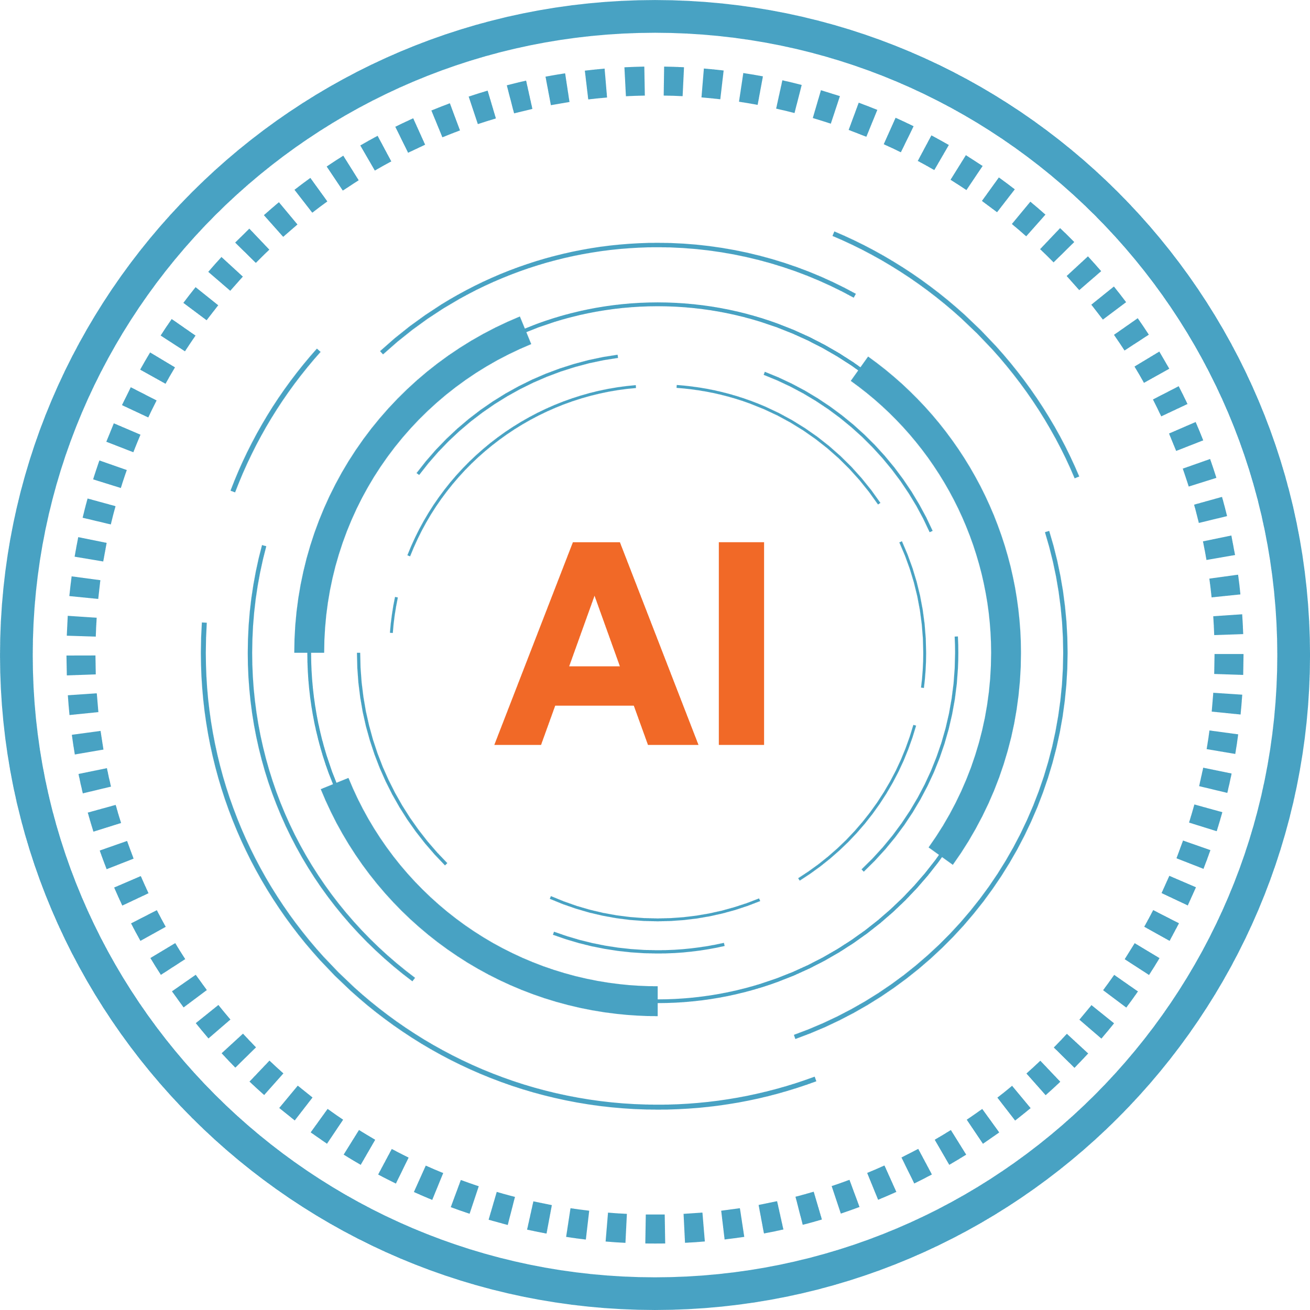


What is AI?
Artificial Intelligence (AI) is the simulation of human intelligence by machines, enabling them to perform tasks that typically require human cognition, such as decision-making and problem-solving.

Slide 4

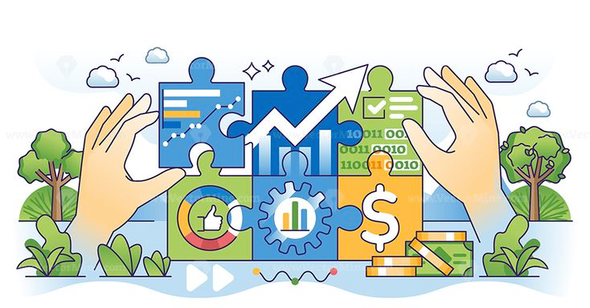

AI enables machines to learn, reason, and adapt.
It involves programming computers to mimic human cognitive functions.
AI ranges from simple automation to complex systems like machine learning
and deep learning.
Widely used in various industries, from healthcare to finance and technology.

Slide 5
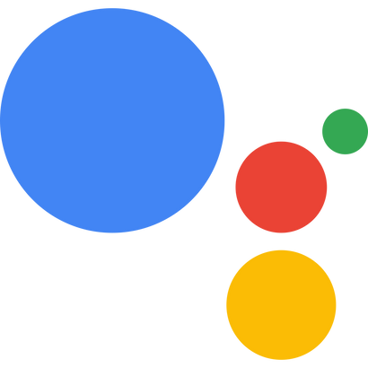
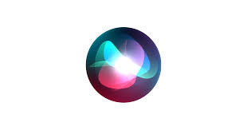
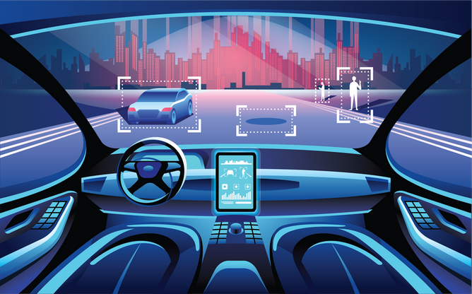

AI in Our Lives:
Virtual Assistants (Siri, Alexa, Google Assistant):
AI-powered voice assistants that help users with tasks like setting reminders, controlling smart home devices, and searching the web.
Self-Driving Cars (Tesla Autopilot):
AI systems process sensor data to make driving decisions, enabling autonomous navigation.
Recommendation Systems (Netflix, Amazon, Spotify):
AI algorithms analyze user behaviour to suggest movies, products, and music tailored to individual preferences.

Slide 6
AI vs ML vs Deep Learning
Artificial Intelligence (AI):
The broader concept of machines mimicking human intelligence to perform tasks autonomously.
Machine Learning (ML):
A subset of AI that focuses on enabling machines to learn from data and improve over time without being explicitly programmed.
Deep Learning (DL):
A subset of ML that uses artificial neural networks to model and understand complex patterns in large datasets.

Slide 7
Key Difference:
AI:
Encompasses all methods to enable machine intelligence.
Includes rule-based systems, automation, ML, and DL.
ML:
Focuses on learning from data.
Algorithms improve through experience (e.g., decision trees, SVM, etc.).
DL:
Uses neural networks with multiple layers (deep neural networks).
Especially effective for tasks like image recognition, speech processing, etc.

Slide 8

AI
ML
DL

Slide 9
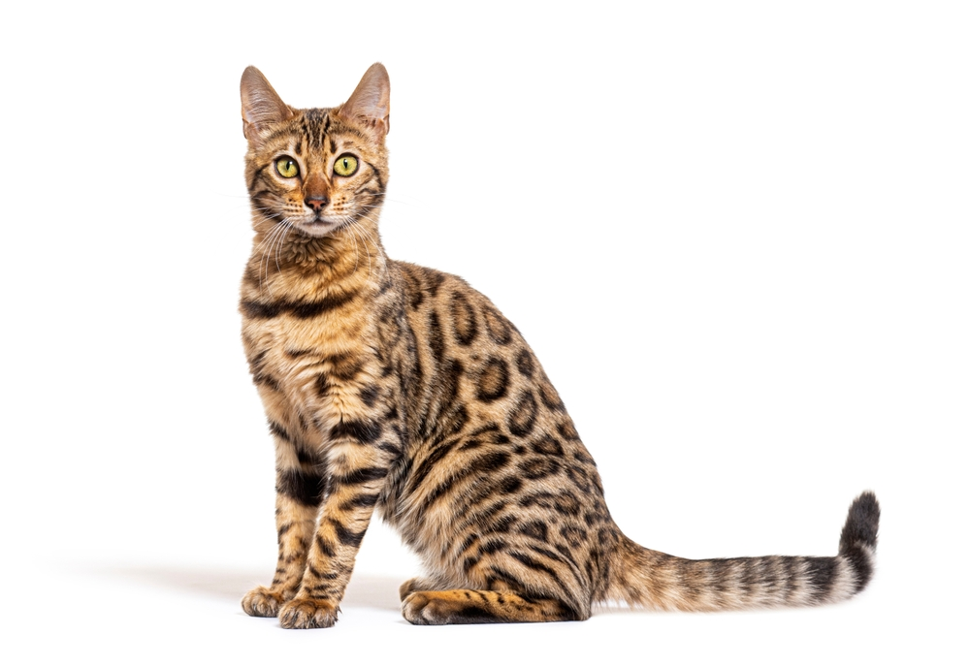

Slide 10
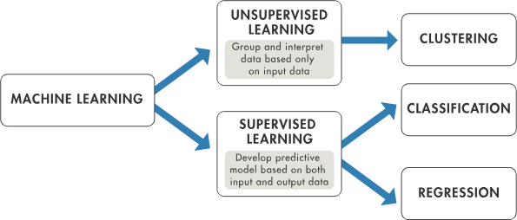
Machine Learning
Machine Learning is a subset of AI that enables machines to learn from data and improve their performance on tasks over time without explicit programming.

Slide 11
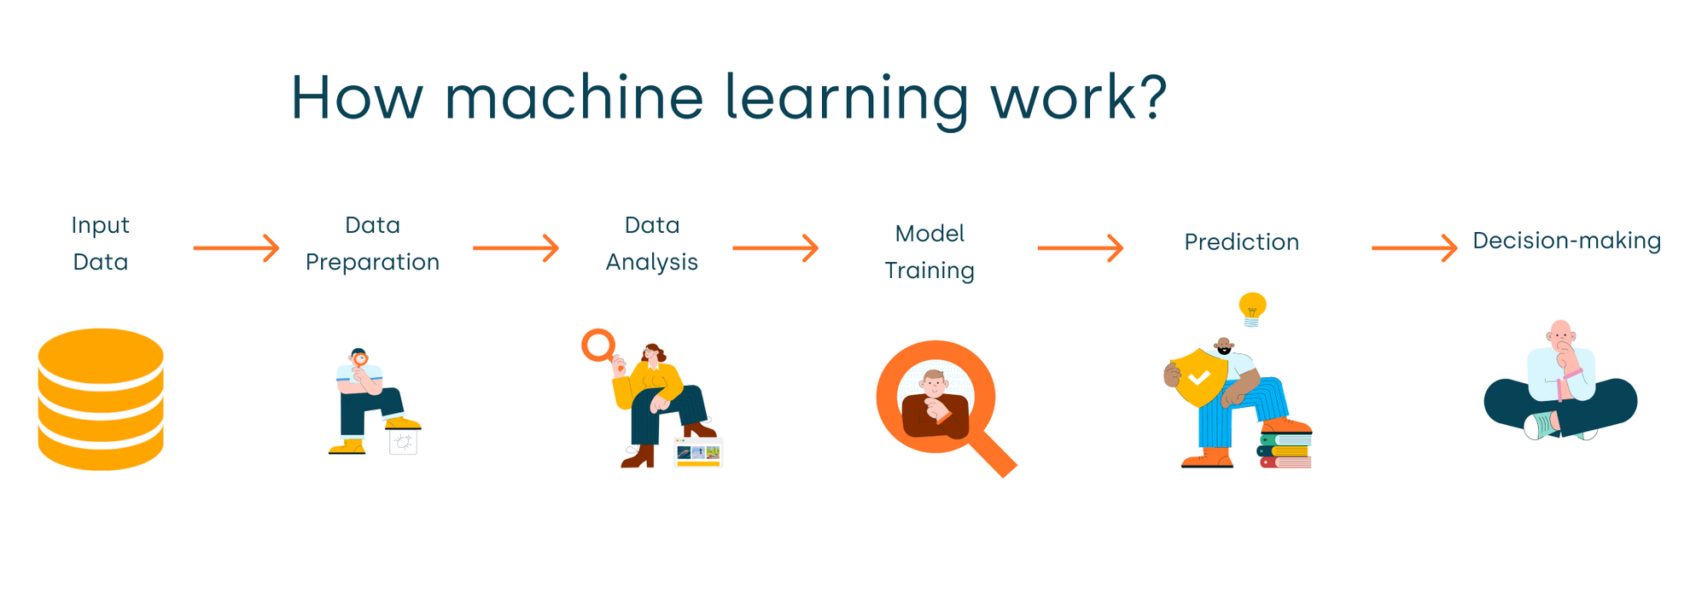
How it works :

Slide 12
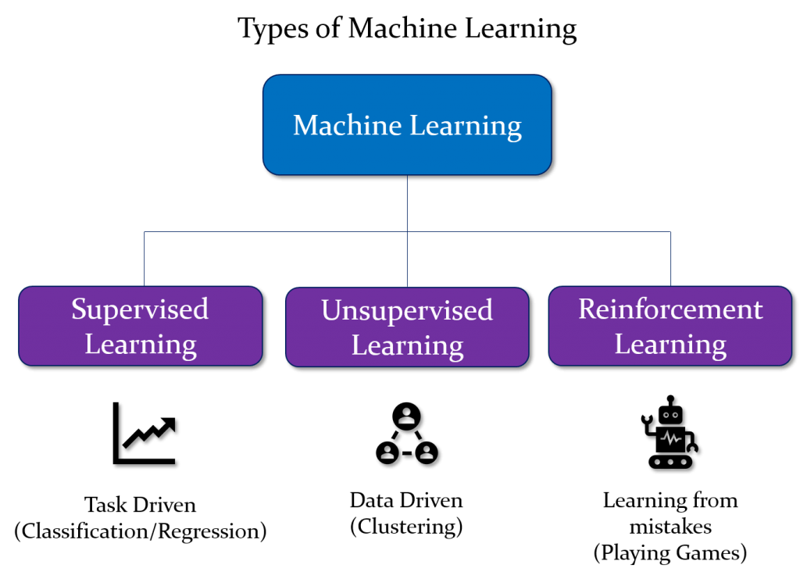
Types of Machine Learning

Slide 13
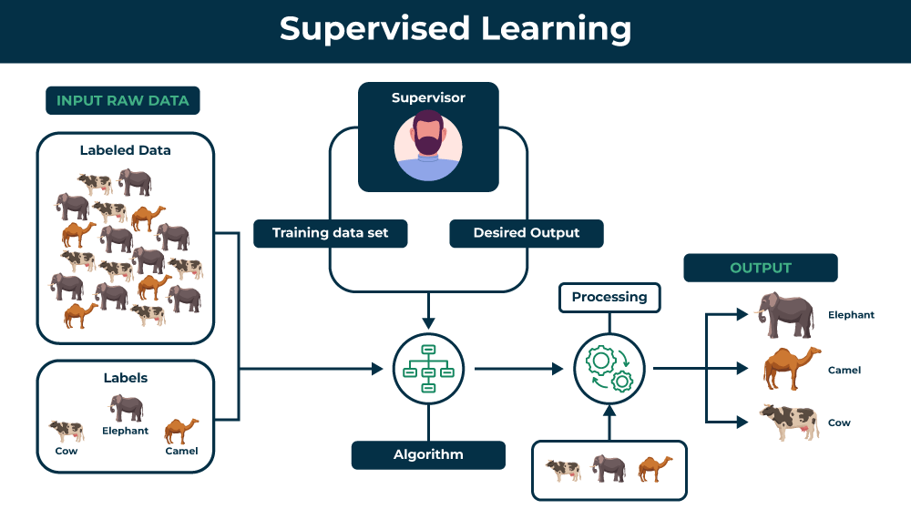

Slide 14
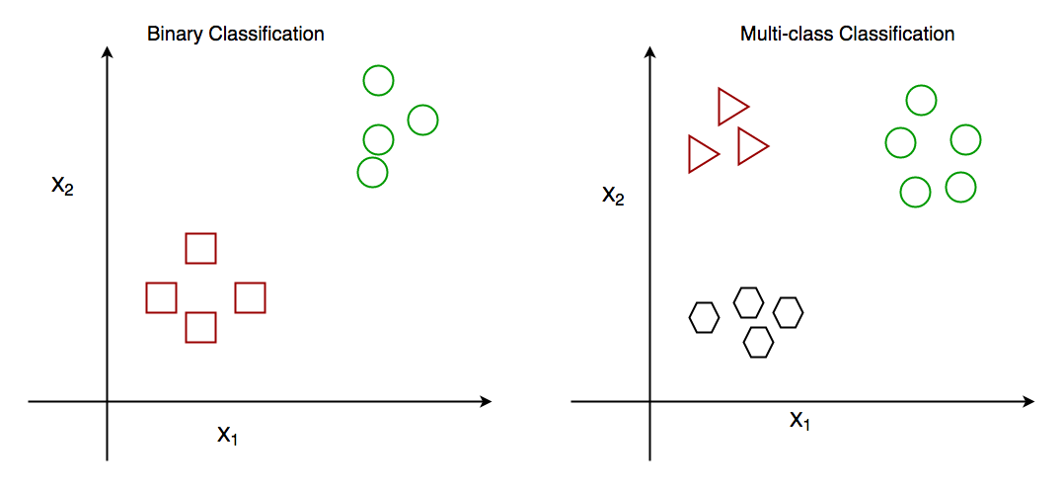
Classification

Slide 15
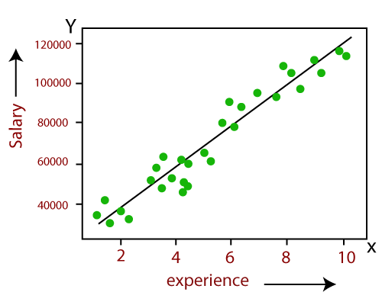
Regression

Slide 16
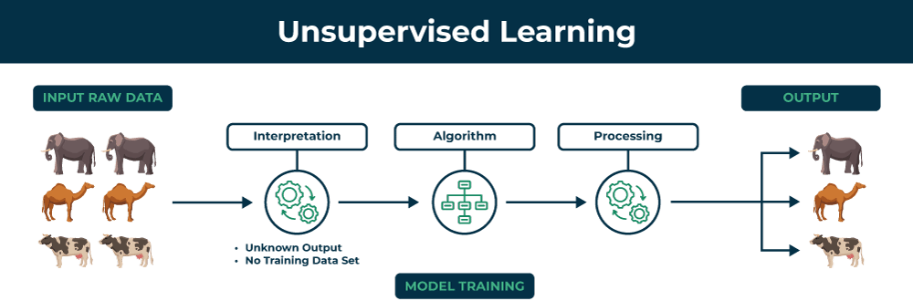

Slide 17
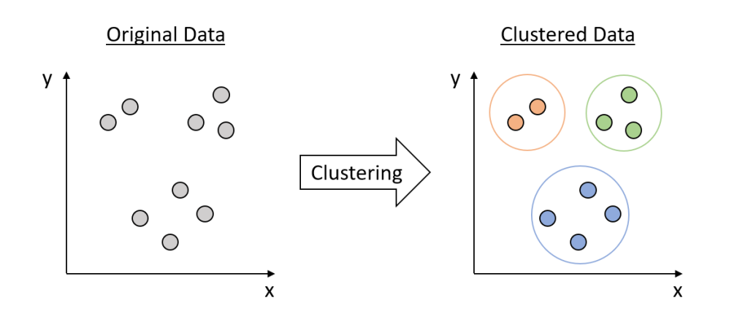
Clustering

Slide 18
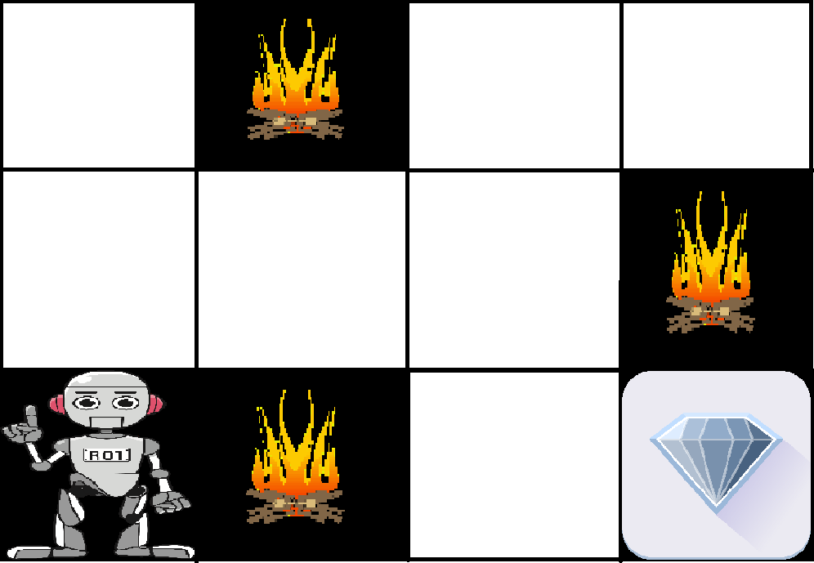
Reinforcement Learning

Slide 19
Advantages of Machine Learning
Automation of Tasks
Data- Driven Decisions
Continuous Improvement
Handling Large Datasets
Pattern Recognition

Slide 20
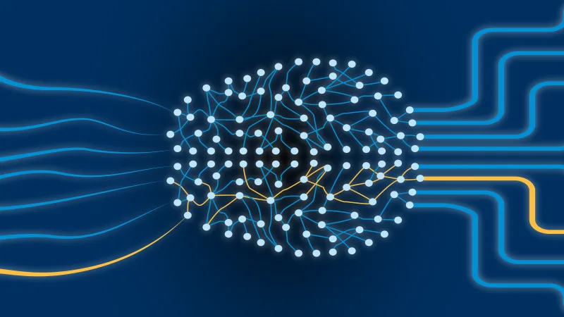
Deep Learning
Deep Learning is a subset of Machine Learning that uses neural networks with many layers (deep neural networks) to model complex patterns in large datasets.

Slide 21
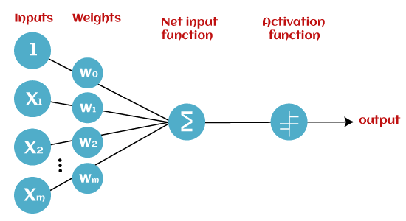
Perceptron
A single-layer feedforward neural network was introduced in the late 1950s by Frank Rosenblatt. Perceptron is one of the first and most straightforward models of artificial neural networks.

Slide 22
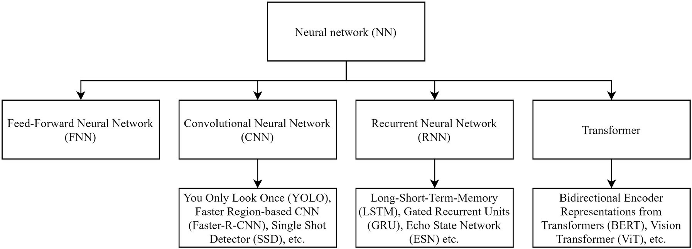
Types of Neural Network

Slide 23
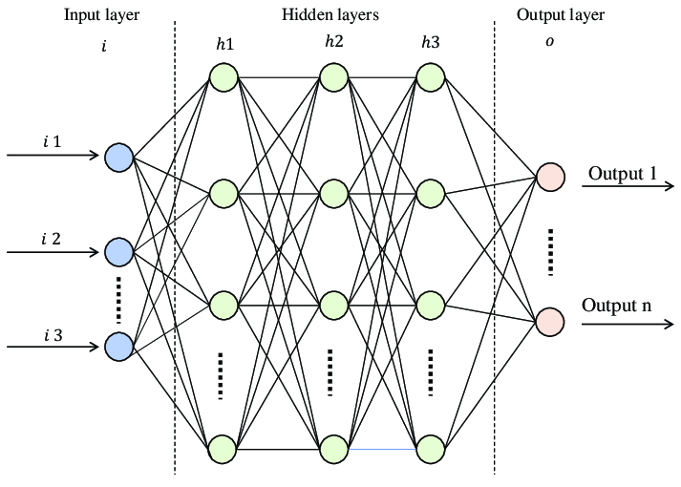
Feedforward Neural Networks(FNN)

Slide 24

Convolutional Neural Networks (CNN):

Slide 25
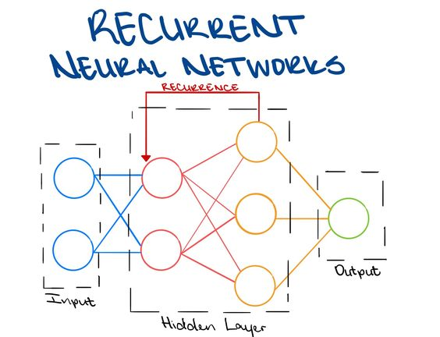
Recurrent Neural Networks (RNN):

Slide 26
Advantage of Deep Learning
Hight Accuracy in complex problems
Scalability with large datasets
Versatility Across Domains
End to End Learning

Slide 27








Generative AI
Generative AI refers to AI systems that generate new content (such as images, text, music, etc.) from input data by learning patterns from existing data. It focuses on creating data that mimics real-world content.
Audio
Images
Video
Textt

Slide 28
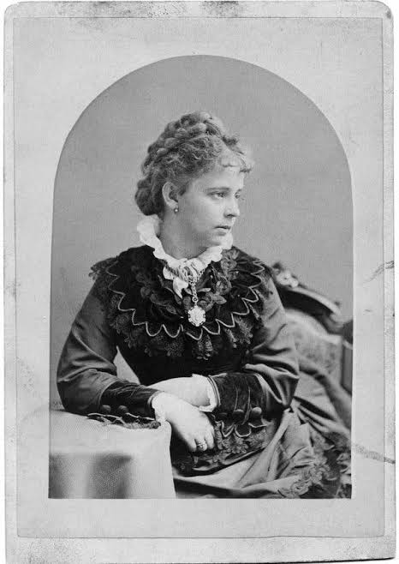
Yesterday is history,
tomorrow is a mystery,
today is a gift of God, which is why we call it the present.
- Alice Morse Earle

Slide 29
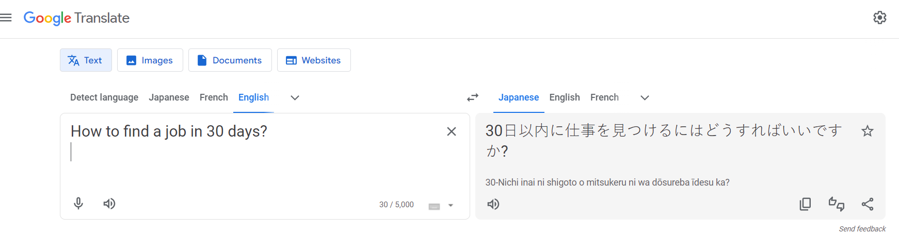
GenAI is not a new concept

Slide 30
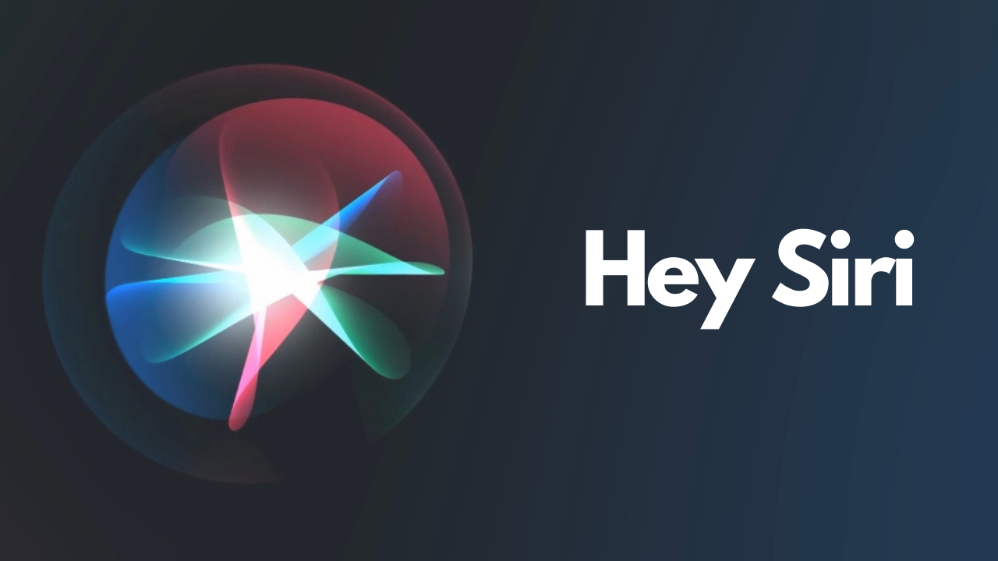
GenAI is not a new concept

Slide 31
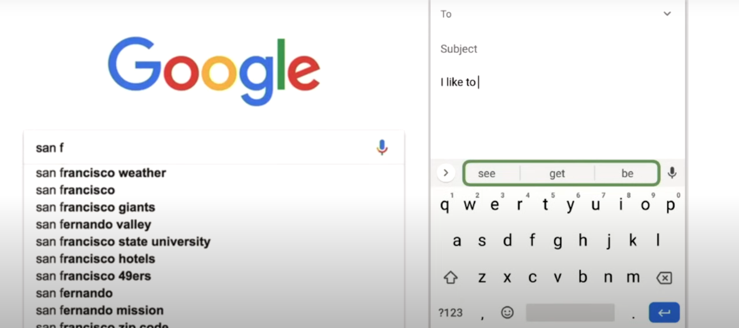
GenAI is not a new concept

Slide 32
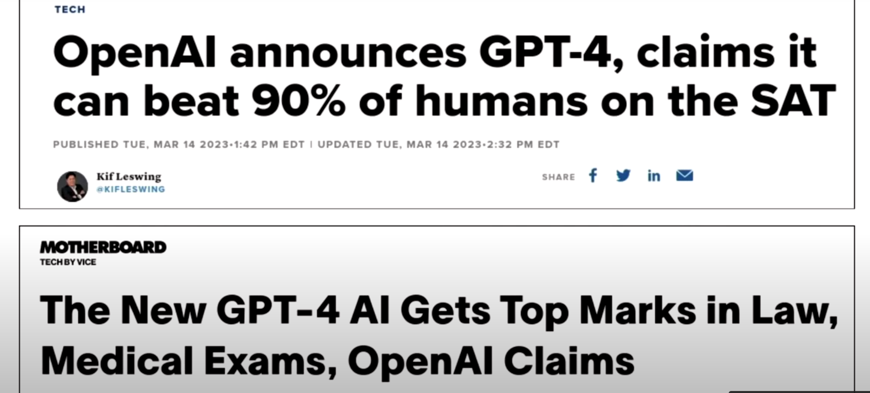
What has Changed?

Slide 33
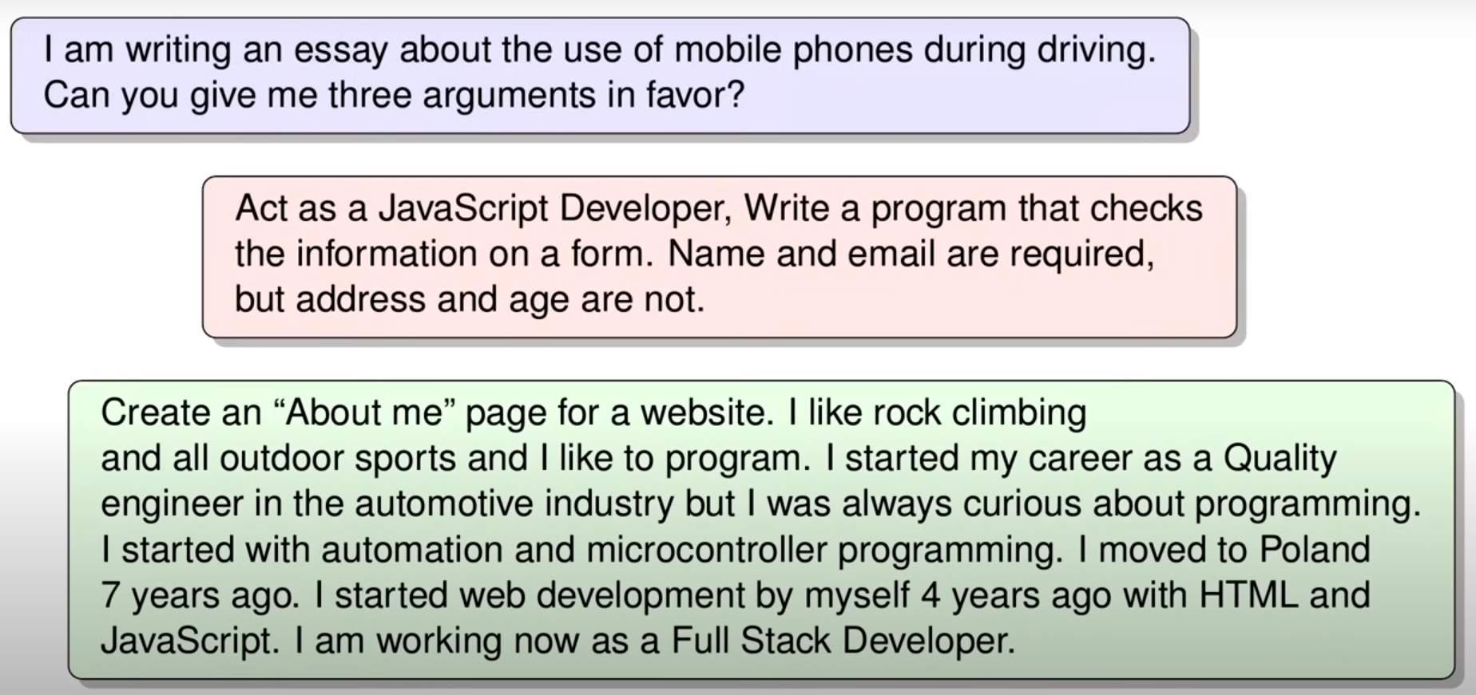
What has Changed?

Slide 34
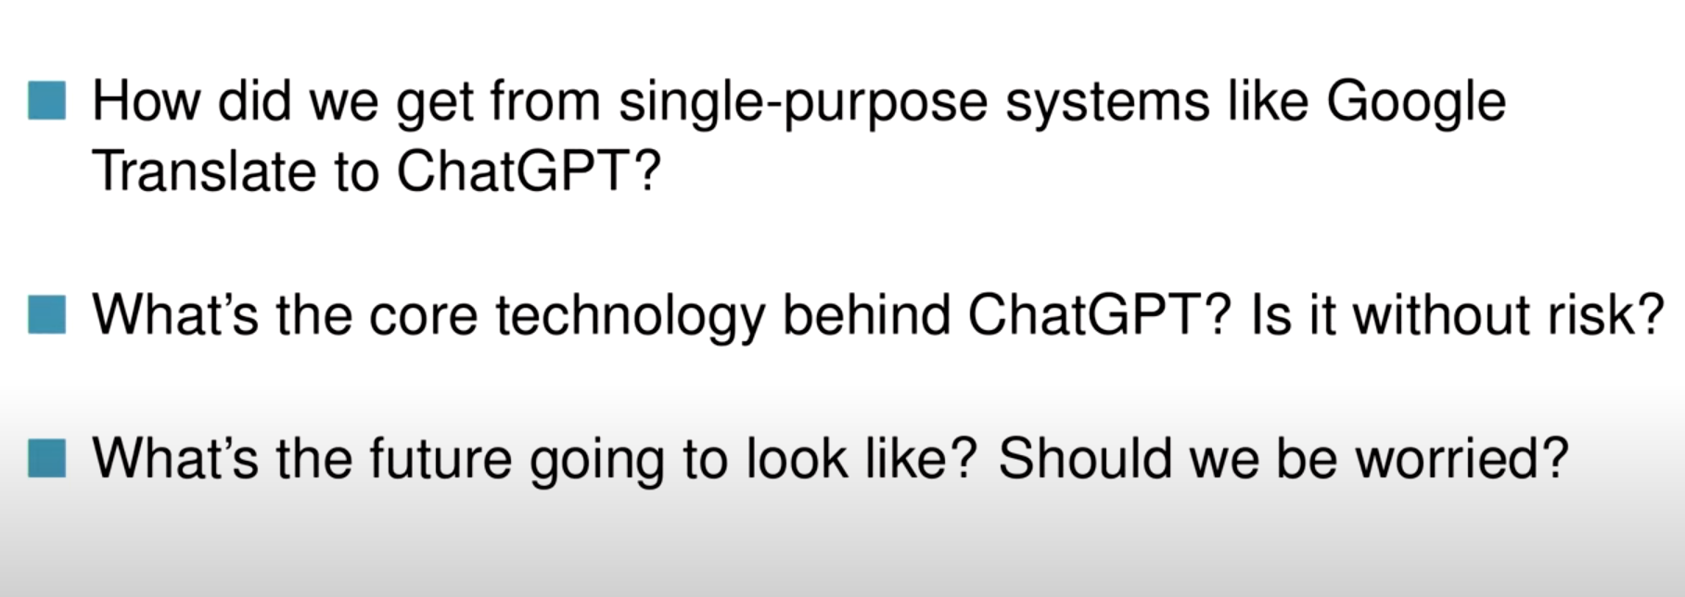

Slide 35
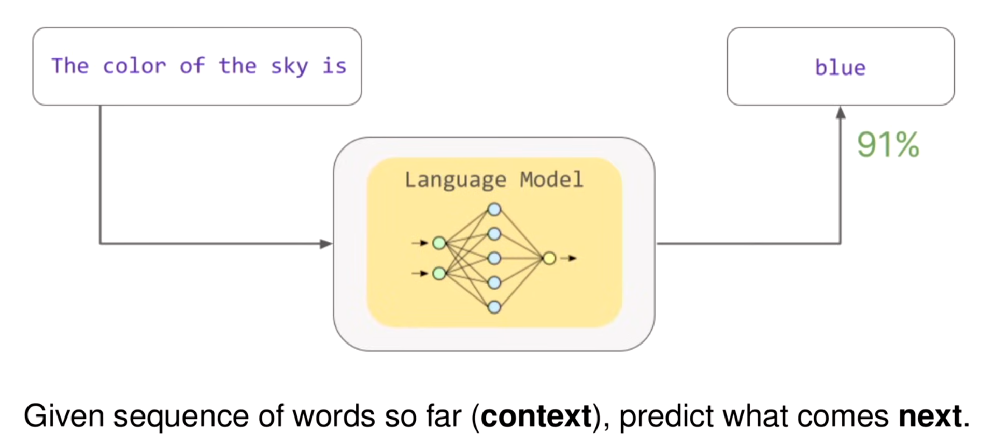
LLM

Slide 36
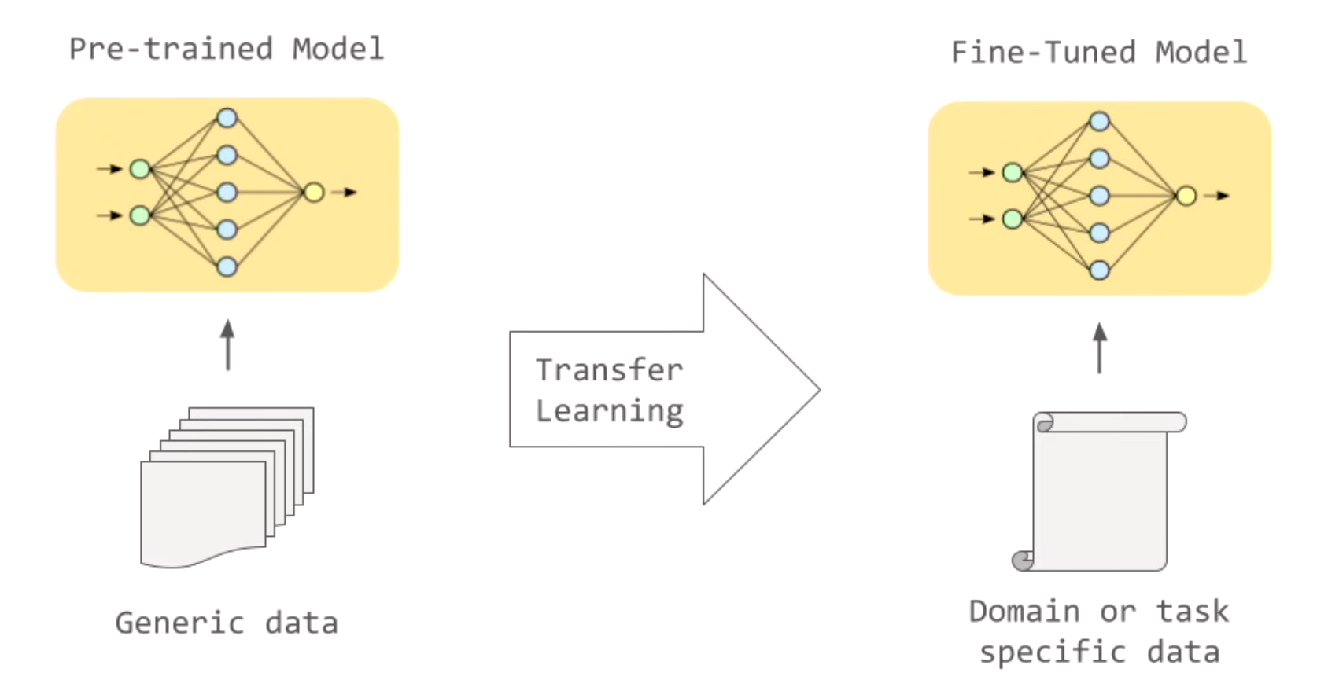
Exploitation of Pre-trained: Fine-Tuning

Slide 37
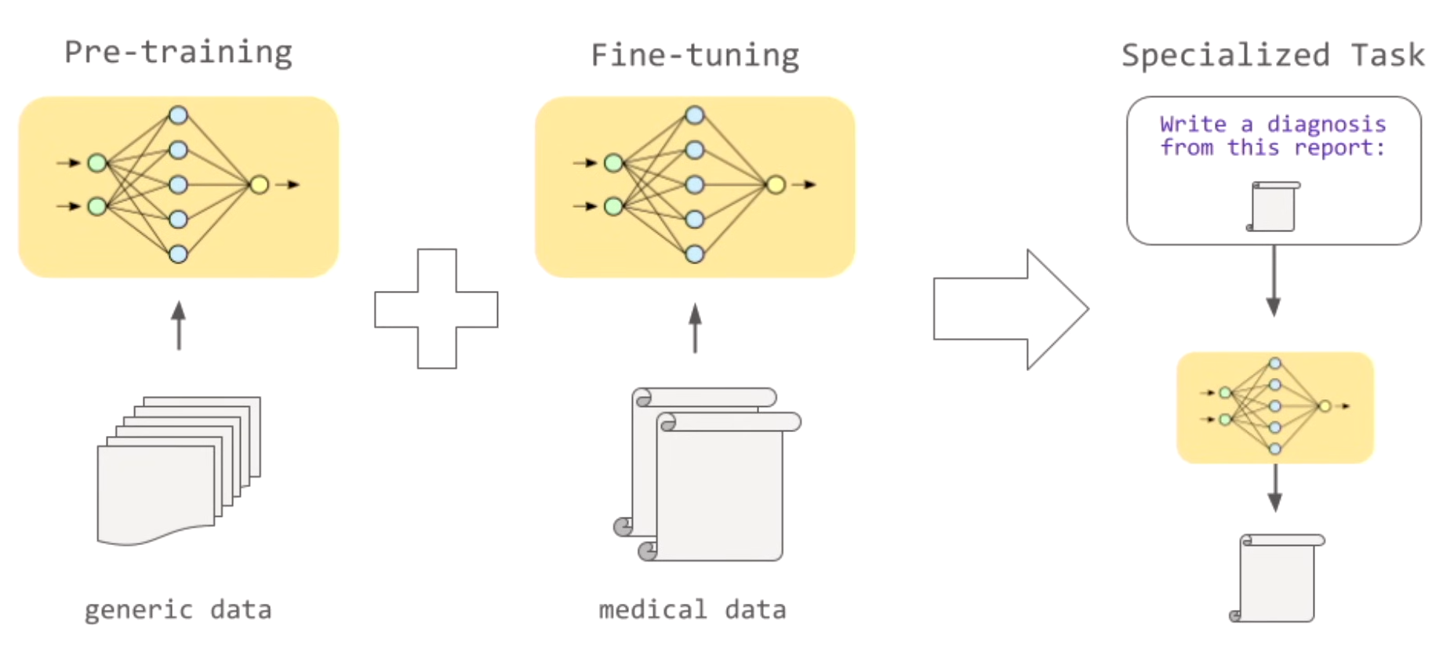
Exploitation of Pre-trained: Fine-Tuning

Slide 38
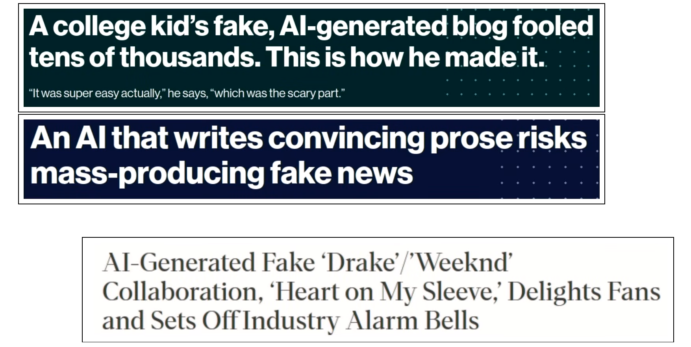
Impact on
Society

Slide 39
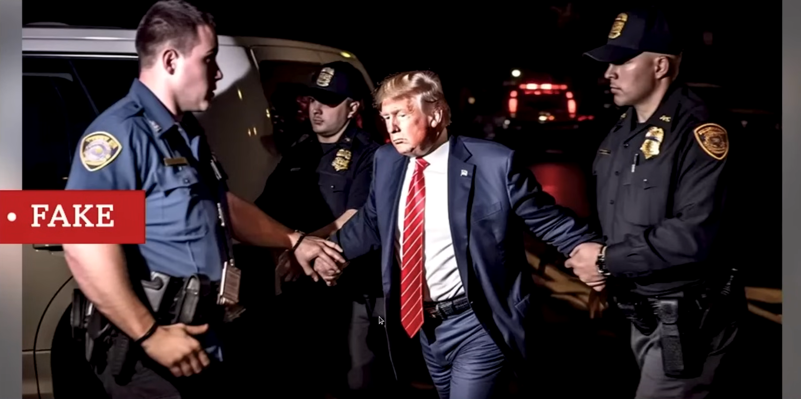
Impact on
Society

Slide 40
Evolution
From recognizing patterns to creating new ones.

Slide 41
Applications of Generative AI
Software CODING
Chatbot Performance Improvement
Written Content Augmentation and Creation
GenAI in the current context
Content Classification
Question Answering and Discovery
Summarization
Tone manipulation

Slide 42
Types in Generative AI
Generative Adversarial Networks (GANs)
Variational Autoencoders (VAEs)
Transformers

Slide 43
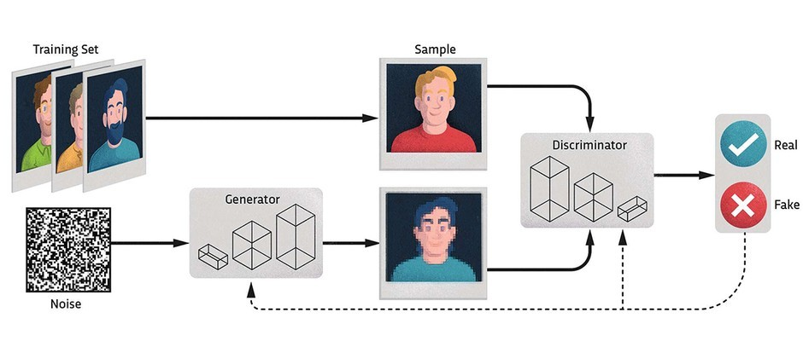
Generative Adversarial Networks (GANs):
Two neural networks (generator and discriminator) work against each other to generate realistic data

Slide 44
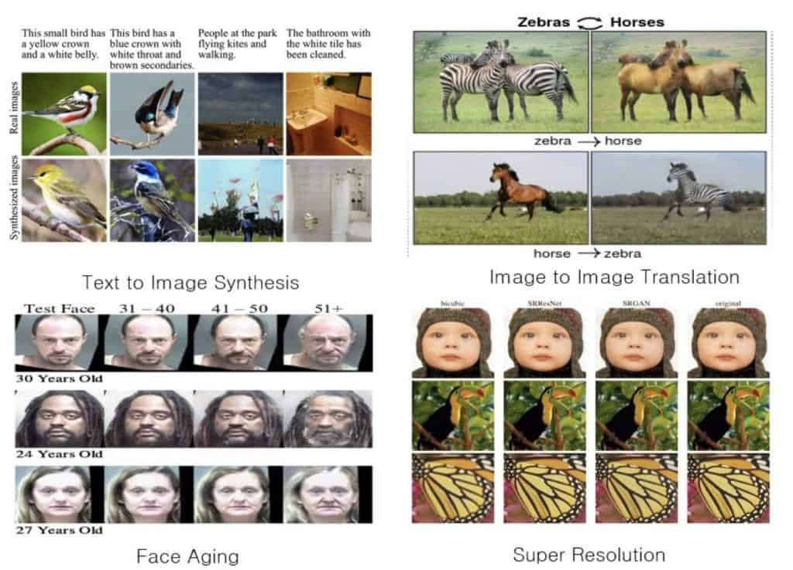
Applications of GANs

Slide 45
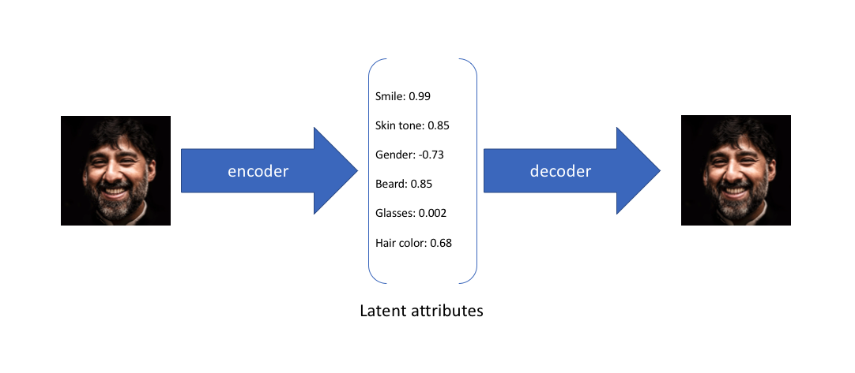
Variational Autoencoders (VAEs):
Encodes data into a lower-dimensional space and then decodes it to generate new data.

Slide 46
Applications of VAEs

Slide 47
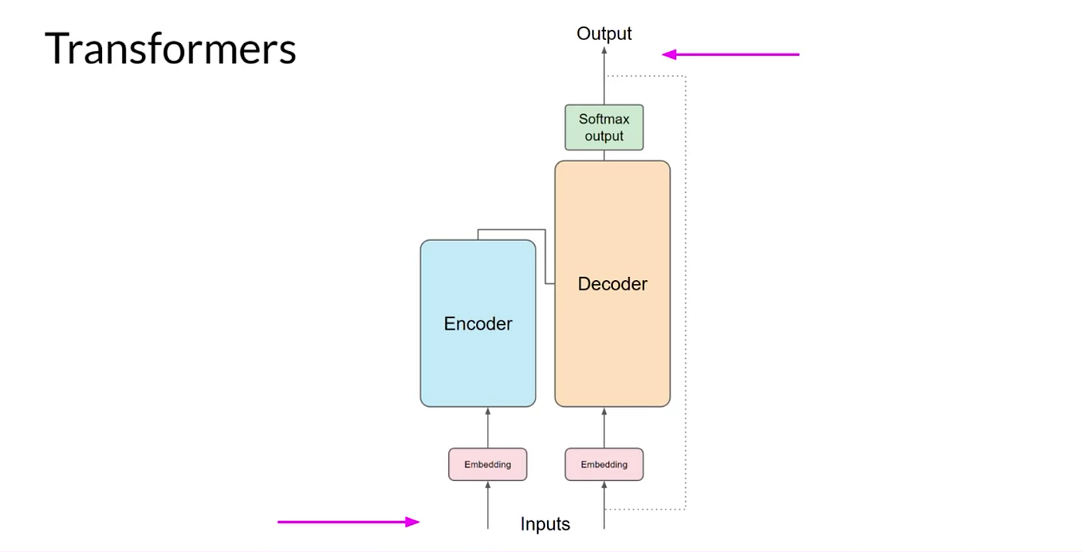
Transformers:
Used in language models like GPT to generate text by learning patterns in sequential data.

Slide 48
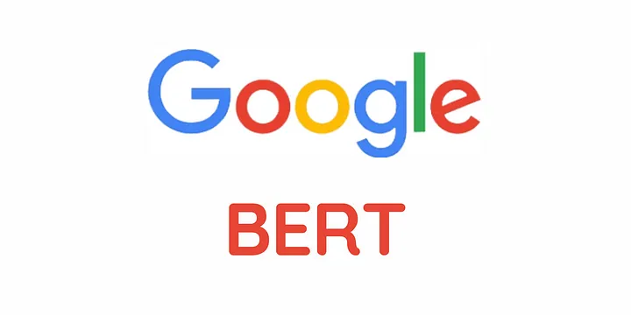
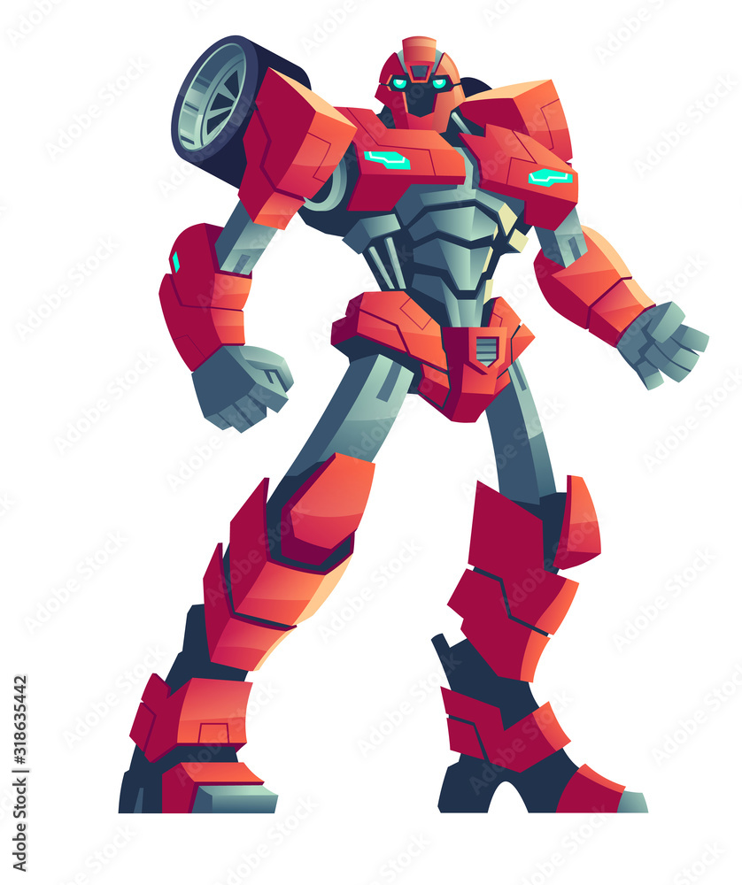
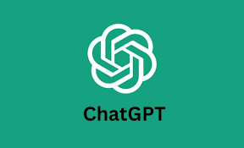
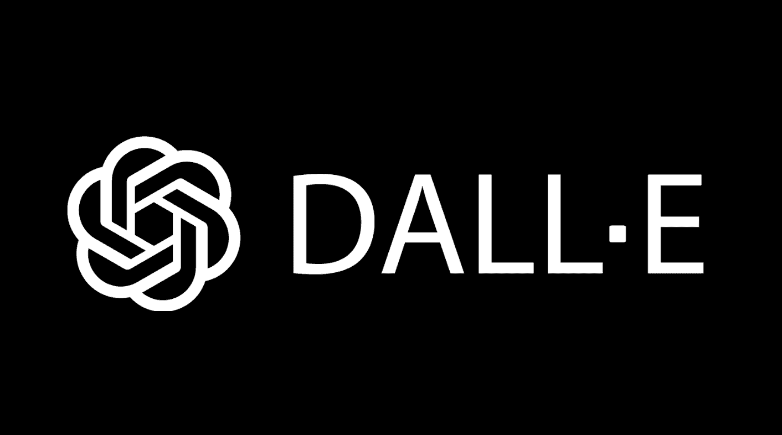
Applications of Transformers
T5

Slide 49




Fine – Tuning and Customizing Generative Models
Fine-tuning is a crucial process in generative AI, where a pre-trained language model is customized for specific tasks or domains.
It involves refining the model’s capabilities to perform specialized tasks.
Summary GPT
Pre - Training
Fine - Tuning

Slide 50
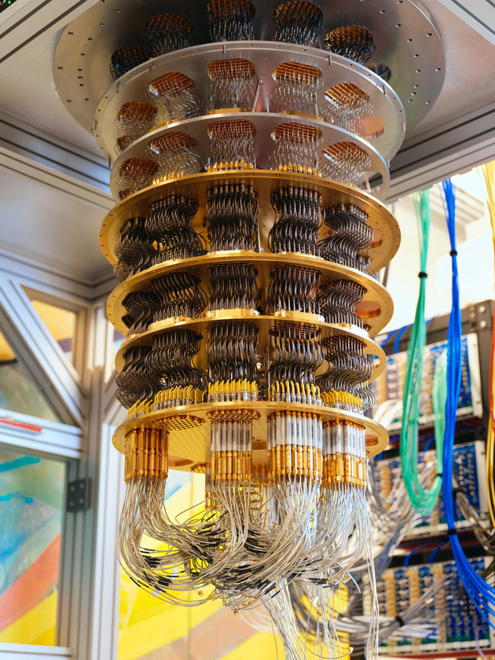
Quantum AI
A quantum computer is a computer that exploits quantum mechanical phenomena. It makes the computation faster and provides efficient results.
A quantum computer can out perform a traditional computer, unlike traditional computer which finds solution one by one, a quantum computers can explore multiple solutions simultaneously.

Slide 51
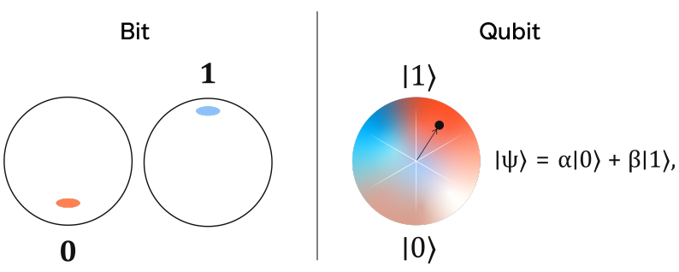
Qubits
A qubit, or quantum bit, is the basic unit of information in quantum computing, similar to how a bit is the basic unit of information in classical computing.

Slide 52
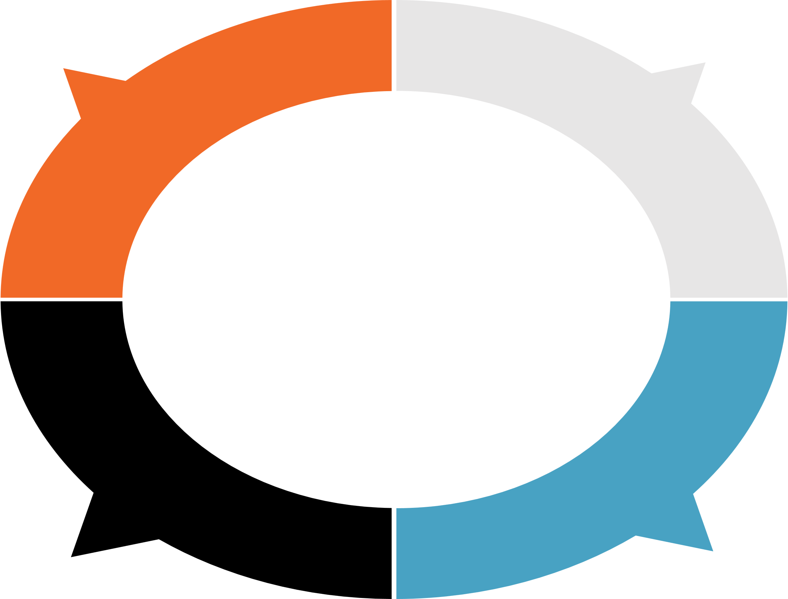
Applications of Quantum AI
QAI computes can break modern encryption
QAI radar can
detect stealth
aircraft
Advancements &Robotics
QAI can speed up drug discovery

Slide 53
THANK YOU!
Notes:
1.7.2013
30
‹#›

